Slide 1



About the Space Force | Careers and Jobs | Benefits | Lifestyles
Notes:
Splash page, might try to animate.

Slide 2

Notes:
Home page with first carousel picture

Slide 3
About the Space Force | Careers and Jobs | Benefits | Lifestyles
Notes:
2nd carousel picture

Slide 4

Notes:
3rd carousel picture

Slide 5

What is a Space Force?
Space Force is the latest and greatest branch of the military. It will be focused on imposing US military influence on current space traffic and anything else in the stratosphere and beyond.
Why do we need this?
What if L. Ron Hubbard was right and Xenu, dictator of the Galactic Confederacy, comes back to earth to eradicate the thetans that remained after he detonated hydrogen bombs to kill the Teegeeack? We must be ready to defend ourselves from this galactic force.
Notes:
About Space force

Slide 6

CHOOSE MORE THAN 150 CAREER PATHS
The Army offers training in more than 150 different career paths. As an active duty Soldier, you will have access to all of them. Choose from jobs in art, science, intelligence, combat, aviation, engineering, law and more. There is no limit to what you can achieve.
GENERAL QUALIFICATIONS
You must be a U.S. citizen
You must be 17-34 years old
You must be in good physical condition
You must have a clean legal record
You must have a high school diploma or GED
Some positions may have additional qualifications.

Slide 7

Joining Space Force will provide you the chance to form great friendships and bonds with your fellow Space Force members.
Enjoy downtime with your friends
Notes:
Carousel #1

Slide 8

Joining Space Force will provide you the chance to form great friendships and bonds with your fellow Space Force members.
Enjoy futuristic music played by your fellow servicemen
Notes:
Carousel #2

Slide 9

Joining Space Force will provide you the chance to form great friendships and bonds with your fellow Space Force members.
Life off planet can be hard, so coed showering is mandatory.
Notes:
Carousel #3

Slide 10
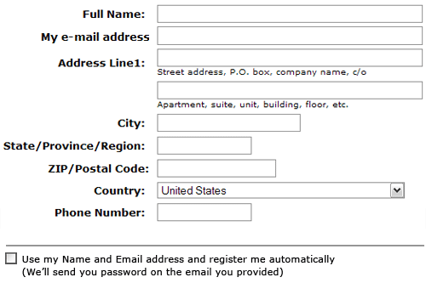
To receive more information about Space Force, please fill out the form below

